Slide 1
C# - GETTING INPUT
and displaying output

Slide 2
Getting input from the keyboard
Getting input from the user is easy using: ReadLine()
You will usually want to start off by asking the user a question eg:
Console.Write(“What is your name: “);
Then read strings in the following way:
String name = Console.ReadLine();

Slide 3
Getting input from the keyboard
Getting input from the user is easy using: ReadLine()
You will usually want to start off by asking the user a question eg:
Console.Write(“What is your name: “);
Then read strings in the following way:
String name = Console.ReadLine();
Notes:
Use write so that the cursor stays on the same line.
Leaving a space before the quote
for the person to answer.
All ReadLine input is string format

Slide 4
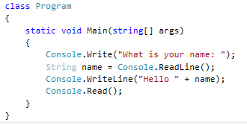
Getting input from the keyboard
Add Console.Read() to keep your program from closing before you can see the output.

Slide 5
Reading different data types
Use Convert. to change your ReadLine input into the format which you want.
int num = Convert.ToInt32(Console.ReadLine());
double longNum = Convert.ToDouble(Console.Readline());

Slide 6
Challenge! Create a custom story...
Create a program which asks the user for at least 3 different types of information.
Store this information in to variables and print out a story which fits the information provided.
Notes:
Set this as an in class or homework task! See who can come up with the most interesting story. Share their stories with their friends.

Slide 7
Outputting data
We want to format data to be outputted nicely on the screen. There are different formats we can use to output numbers using the ToString() function:
c currency
p percent
n number
f float
e exponential
g general
num.ToString(“f2”) - formats “num” to have a $ and 2 decimal places

Slide 8
Outputting Data - Example
Practice this in Visual Studio. Experiment with different datatypes and formats.

Slide 9
Padding Output
Sometimes your output might need to be lined up down the screen or in columns.
The best way to do this is to use Padding
name.PadLeft(30) - Adds spaces on the left of the string “name”
name.PadRight(30) -Adds spaces on the right of the string “name”
Note: this makes the entire string a total of 30 characters

Slide 10
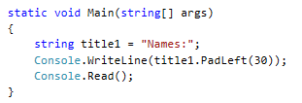
Padding example

Slide 11
Practice task
You want to gather information from the user about the book they are reading.
You can include things like: name of the book, how they are reading it (paper, digital), how much it would cost to buy, how many pages it has.
Ensure you store the data in the correct variable datatypes.
Format the output to look nice on the screen.

Slide 12
Error Handling
When you are getting input sometimes users may enter the wrong data.
What happens if you ask for an “int” and the user types a string?
This is what you expected:
This is unexpected input

Slide 13
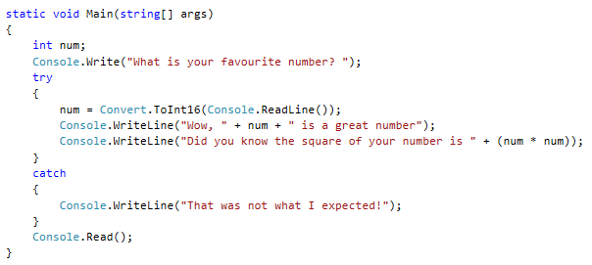
Error Handling
We can use a Try… Catch to stop our program from crashing if the user enters unexpected input.
Try this!
Or modify one of your own programs to have a try, catch.

Slide 14
Creating a reusable method for checking input
If we are going to be asking for a lot of input then it makes sense to create a reusable method
Below is a Method called ReadInt
This can be used every time you want to ask the user for data of type Int, the method will do the checking for you.

Slide 15
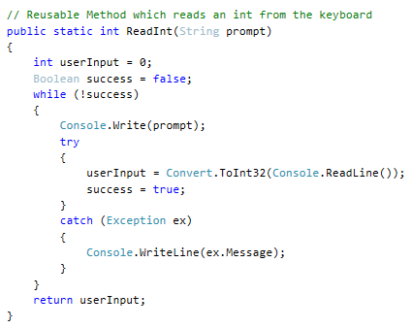
ReadInt()
Notes:
The method accepts a string “prompt” and uses this to ask the user to enter.
It keeps asking the user until they enter the correct value.

Slide 16
Side note: Methods
The last slide introduced the ReadInt method. Which was declared as:
public static int ReadInt(String prompt)
What does this mean?
The int before “ReadInt” is the Return type
The method name is ReadInt
The part in the parentheses is called Parameters
To call this method you must match the declaration, eg:
have an Int variable for it to return into
use the correct name
Put arguments into the parentheses
int num = ReadInt(“a string”);
A method doesn’t need to have a Return type. If it doesn’t it will say void
A method also doesn’t need to have parameters, it will have ()
eg: public static void PrintHello()
Notes:
https://docs.microsoft.com/en-us/dotnet/csharp/programming-guide/classes-and-structs/methods

Slide 17
Task:
Add the ReadInt method into one of your existing programs
Create yourself a ReadDouble method
Have a think and a chat with your friend about how you could create a ReadString Method – what makes a string valid or invalid?

Slide 18
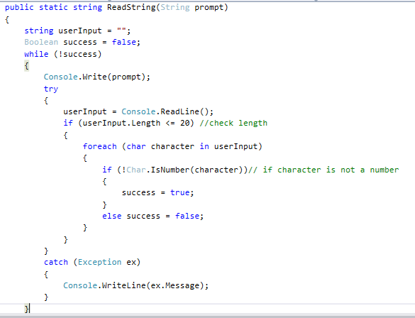
ReadString idea
Notes:
This does 2 checks on your string
1 – if the length is less than 20
2 – That there are no numbers in it
What kind of data would this be good for?

